Slide 1
BIGTECHCOMPANY
Financial Overview

Slide 2
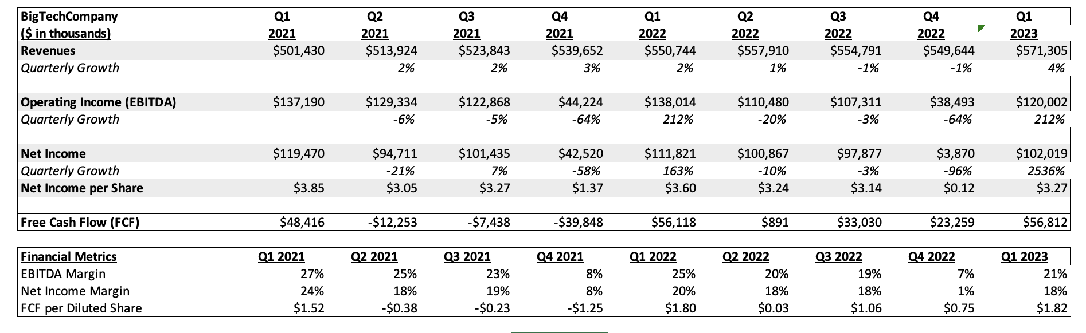
QUARTERLY PERFORMANCE

Slide 3
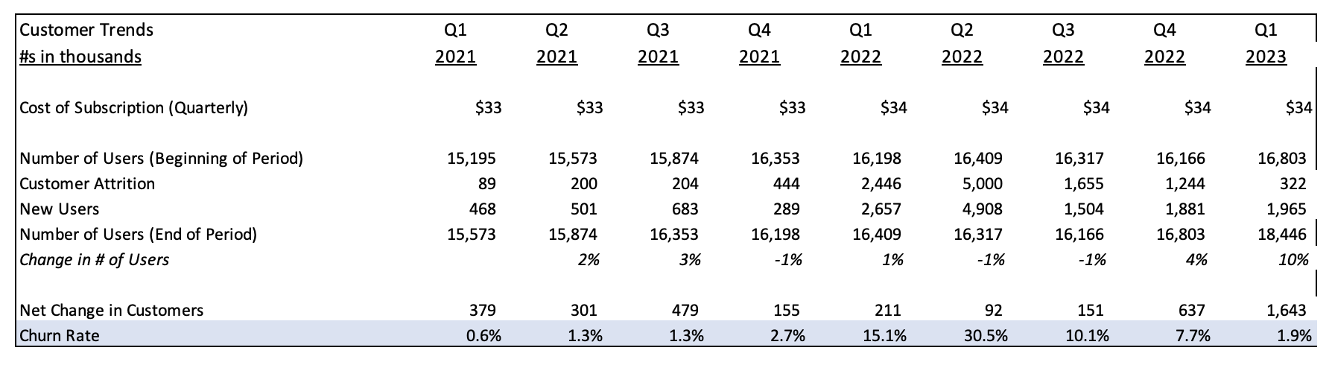
CUSTOMER TRENDS
Key Takeaways:
Customer numbers are trending positively overall, with the user base growing from ~15.2K in Q1 2021 to over 18.4K by Q1 2023 — indicating healthy acquisition.
Despite a price increase from $33 to $34 starting Q1 2022, customer attrition remained manageable, with churn rate peaking only briefly during Q1 and Q2 2022 when attrition jumped to 2,446 and 5,000 respectively.
Churn rates have stabilized, and new user acquisition has consistently outpaced attrition, particularly in Q4 2022 and Q1 2023 — supporting a strong, loyal customer base.

Slide 4
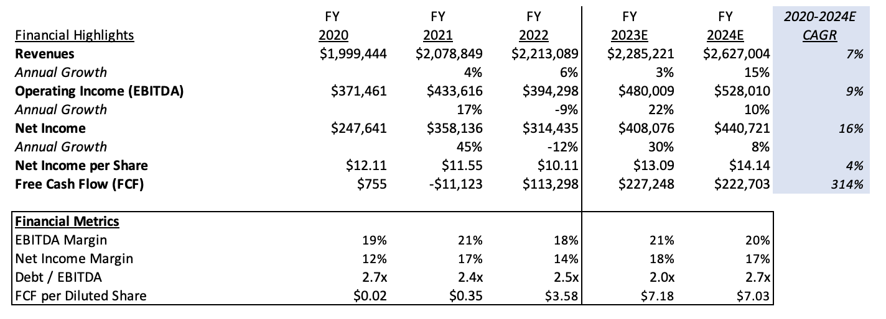
PROJECTIONS

Slide 5
CONCLUSIONS
Company Highlights
Revenue steadily increased from $2.08B in 2021 to a projected $2.63B by 2024, showing strong growth momentum.
Free cash flow improved significantly, turning from negative in 2021 to over $220M by 2023E–2024E, indicating efficient capital management.
Debt/EBITDA remained consistently low at 2.7x, well below the 4.0x industry benchmark — a strong indicator of financial health.
Net income per share grew from $8.38 to a projected $14.91, signaling solid profitability for investors.
Areas of Concern
Quarterly net income and free cash flow were volatile in 2021, with Q4 showing significantly lower results than other quarters.
Customer attrition temporarily spiked in early 2022 following a price increase, though it later stabilized.
EBITDA margin averaged ~20%, well below the 39% industry benchmark — suggesting potential inefficiencies in operations or spending.
Recommendation
"BigTechCompany” is financially strong and presents low leverage, high growth, and positive long-term indicators. We recommend moving forward with developing a relationship with the company.
We should ask for clarification on the drop in EBITDA margins compared to industry standards, and the Q4 2021 earnings decline to better understand risk exposures.

